Slide 1

Traffic Crash Analytics & Safety Intelligence Platform
Project Report Presentation

Slide 2
Problem Statement
Traffic crash data contains valuable insights that can help
Improve road safety
optimize emergency response
support policy decisions
However, extracting meaningful insights from large-scale structured data requires strong SQL and analytical skills.

Slide 3
Objectives
Analyze crash data using advanced SQL techniques.
Identify patterns, trends, and risk factors.
Generate business insights from structured data.
The focus is on SQL-based problem solving, analytical thinking, and insight generation, similar to real-world data analyst and data engineer roles.

Slide 4
Approach
Data loading and Understanding (read csv and load the data in dataframe using pandas library, try to understand the data like number of columns and data type).
Connecting MySQL server.
Create Database.
Wrote a function to find the length of String and maximum int and float values which helps to create Table in Database.
Create Table.
Insert Data into Table from dataframe.
Wrote Queries in MySQL workbench and applied the same in python file to retrieve the required output.
Used Streamlit for displaying the result in Table format.
Used Matplotlib library to display the table output as chart.
Wrote business insight from the output from the Table.

Slide 5
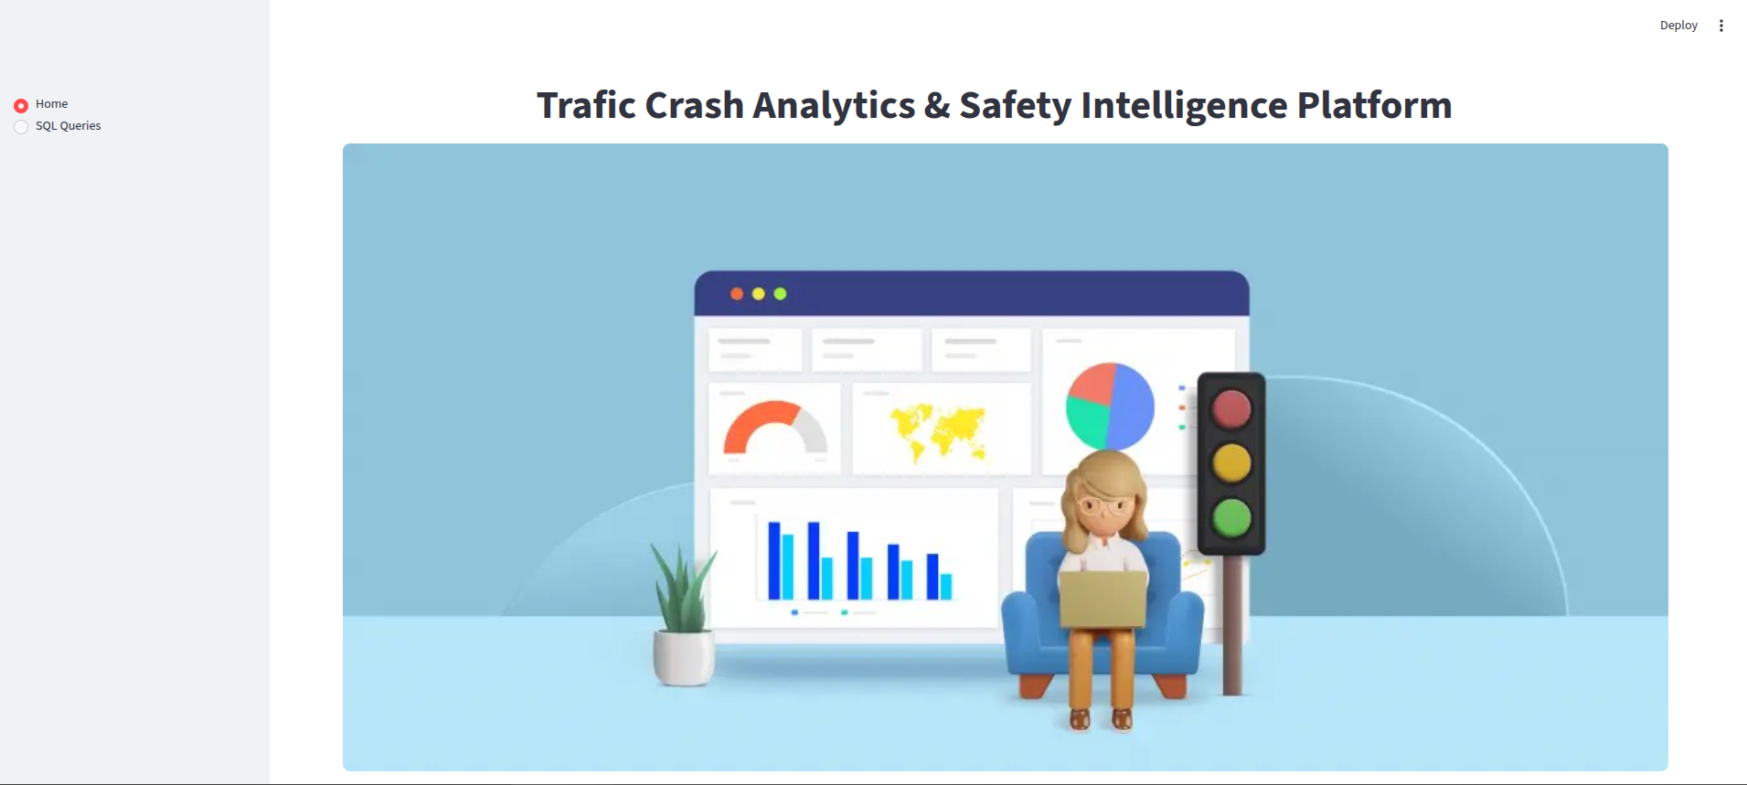
Result Home Page

Slide 6
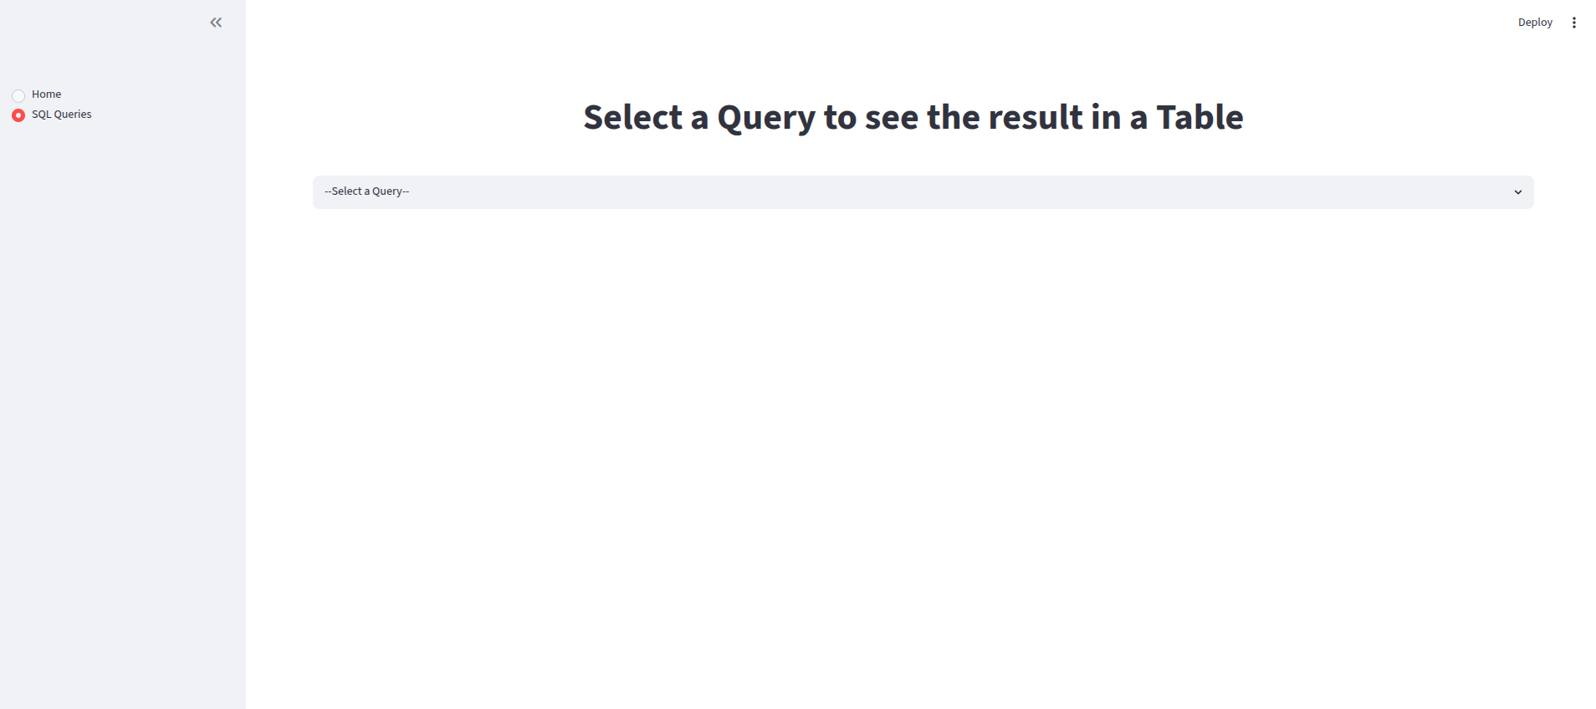
Navigation

Slide 7
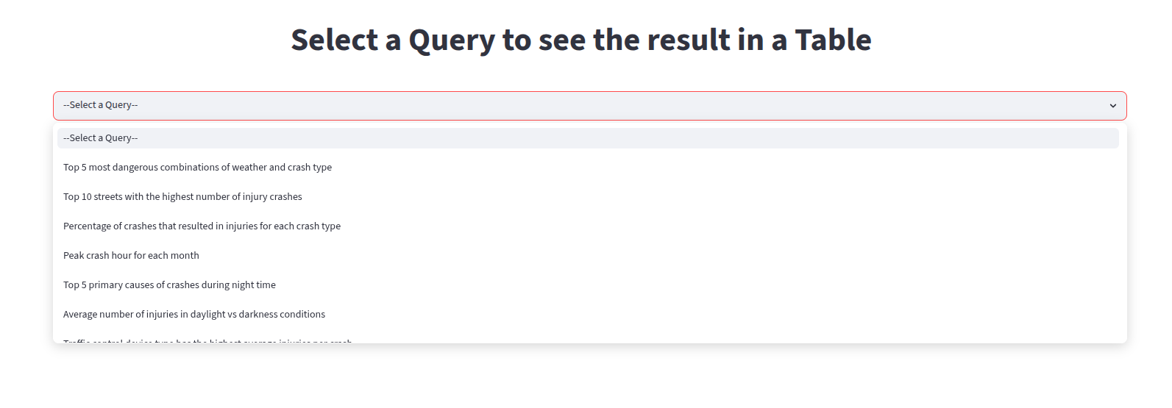
Selectbox

Slide 8
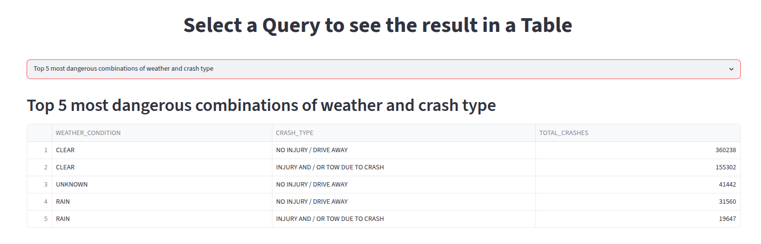
Top 5 most dangerous combinations of weather and crash type
Insight:
Most crashes occurred under clear weather conditions, with non-injury or drive-away crashes recording the highest number of incidents (360,238 crashes). Injury-related crashes were also significantly higher during clear weather, likely due to increased traffic volume in normal weather conditions.

Slide 9
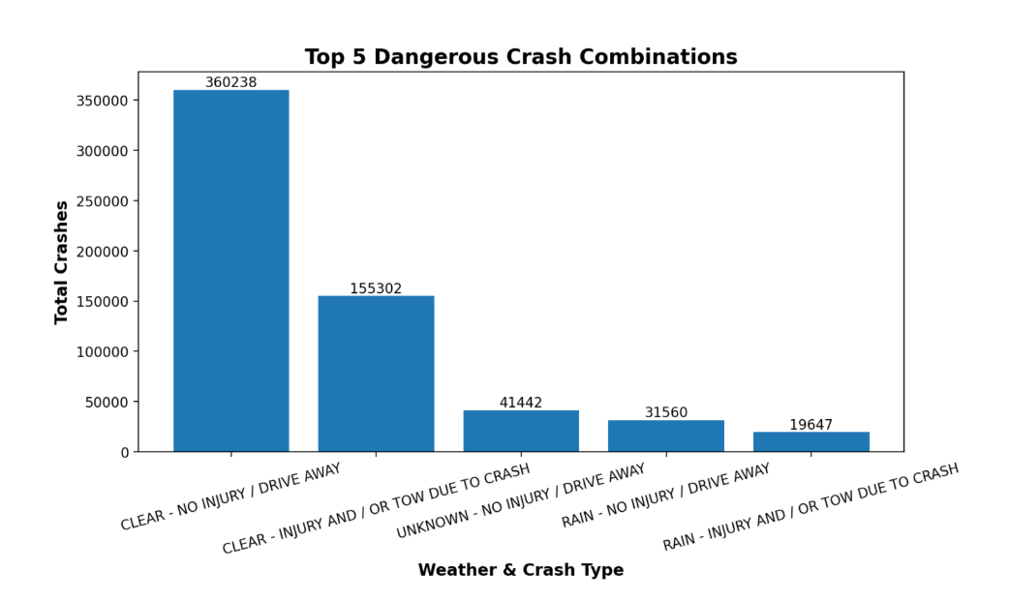

Slide 10
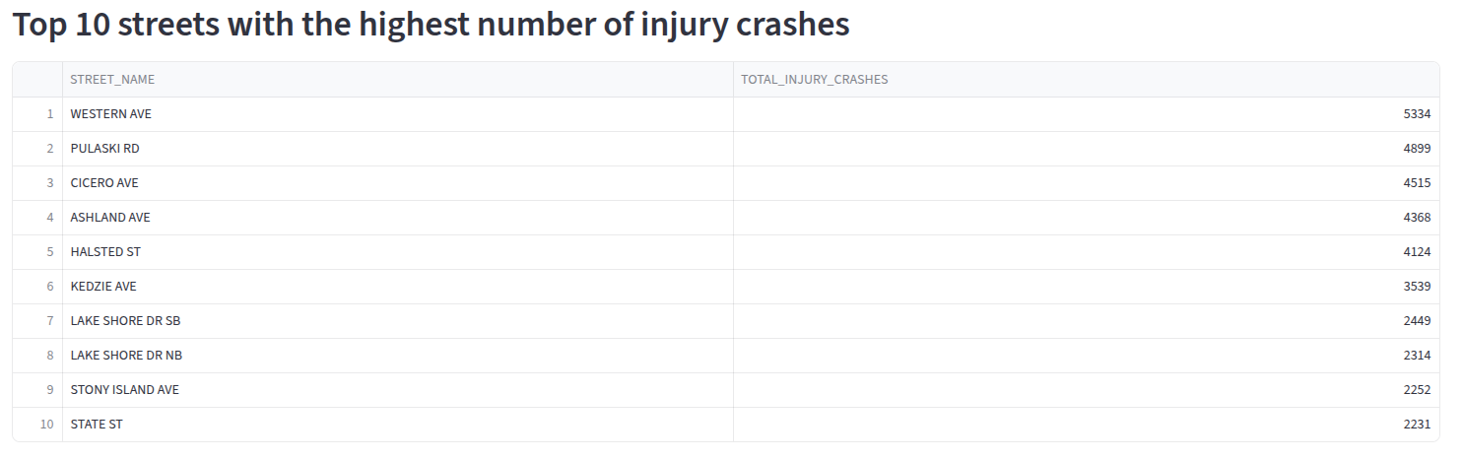
Top 10 streets with the highest number of Injury crashes
Insight:
Western Ave recorded the highest number of injury crashes (5,334), followed by Pulaski Rd and Cicero Ave, indicating that major arterial roads are high-risk zones for injury-related accidents. High-traffic corridors such as Ashland Ave, Halsted St, Kedzie Ave, and Lake Shore Dr also emerged as major crash hotspots, likely due to dense traffic flow and heavy commuter activity.

Slide 11
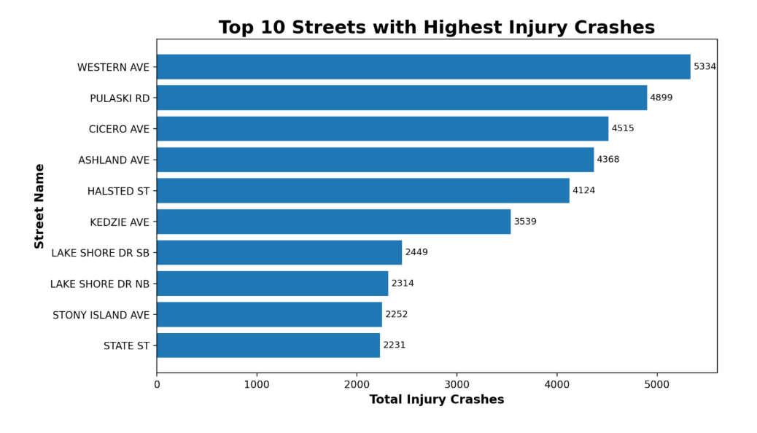

Slide 12
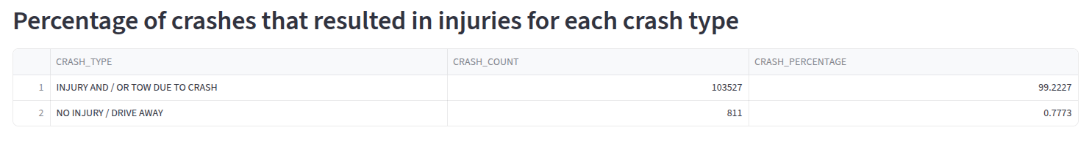
Precentage of crashes that resulted in injuries for each crash type
Insight:
The dataset is heavily dominated by severe crashes, with 99.22% (103,527 crashes) resulting in injuries or vehicle towing, while only 0.78% were minor no-injury incidents. This highlights the high severity of recorded crashes and emphasizes the need for stronger road safety and traffic management measures.

Slide 13
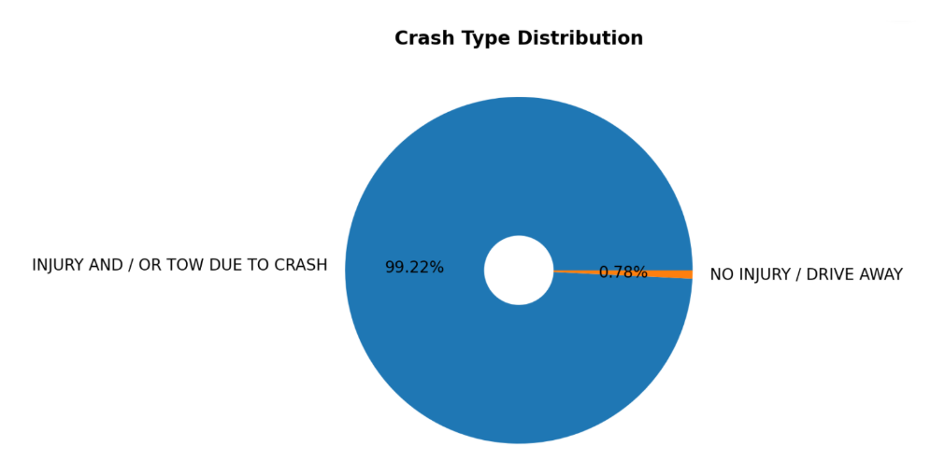

Slide 14
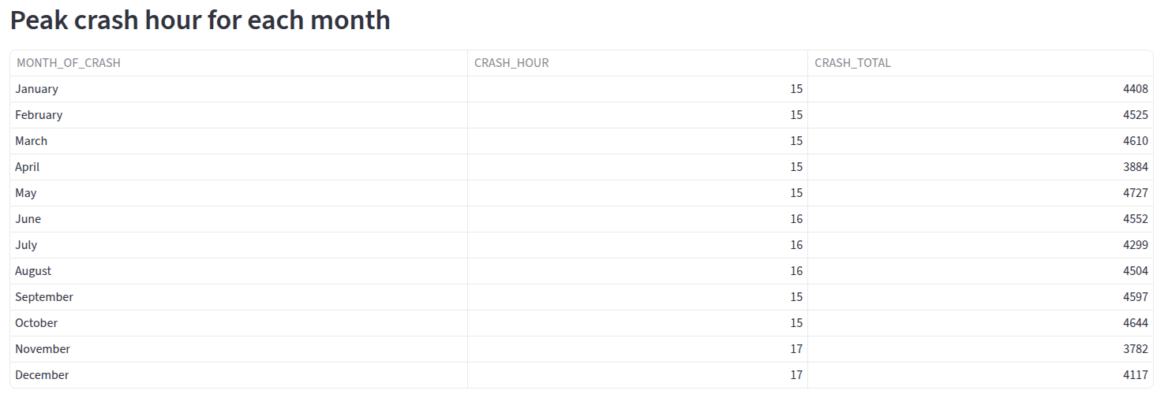
Peak crash hour for each month
Insight:
Crash frequency consistently peaks during late afternoon and evening rush hours (3 PM–5 PM) across all months, indicating that heavy commuter traffic and congestion significantly increase accident risk. May recorded the highest peak-hour crashes, while seasonal shifts in peak timing suggest that daylight changes and varying traffic patterns influence crash occurrence throughout the year.

Slide 15
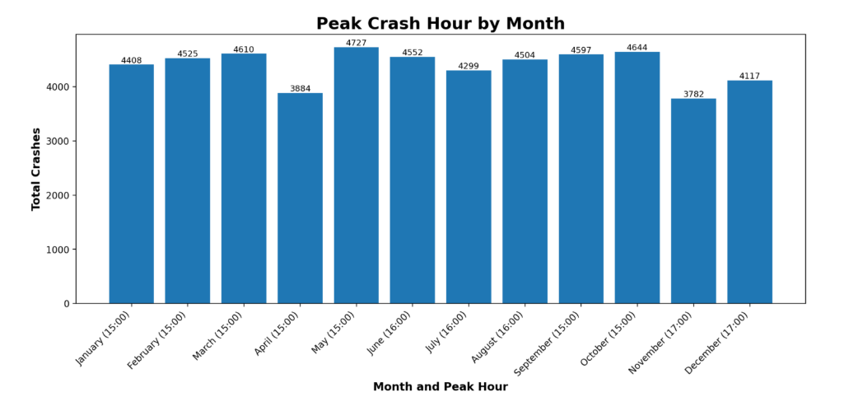

Slide 16
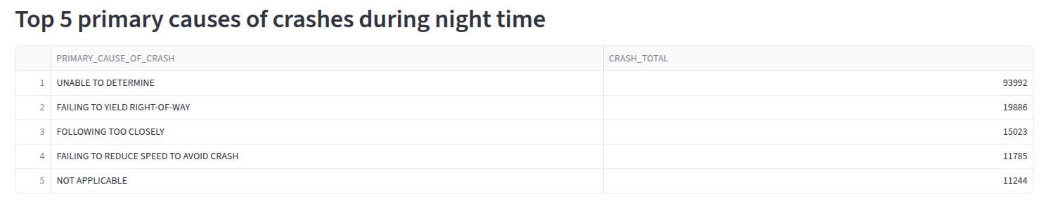
Top 5 primary causes of crashes during night time
Insight:
Night-time crashes were most commonly linked to “UNABLE TO DETERMINE,” suggesting difficulties in identifying causes due to poor visibility and limited evidence at night. Among identified causes, failing to yield, following too closely, and speeding-related behavior were major contributors, highlighting the need for better lighting, speed control, and night-time traffic monitoring.

Slide 17
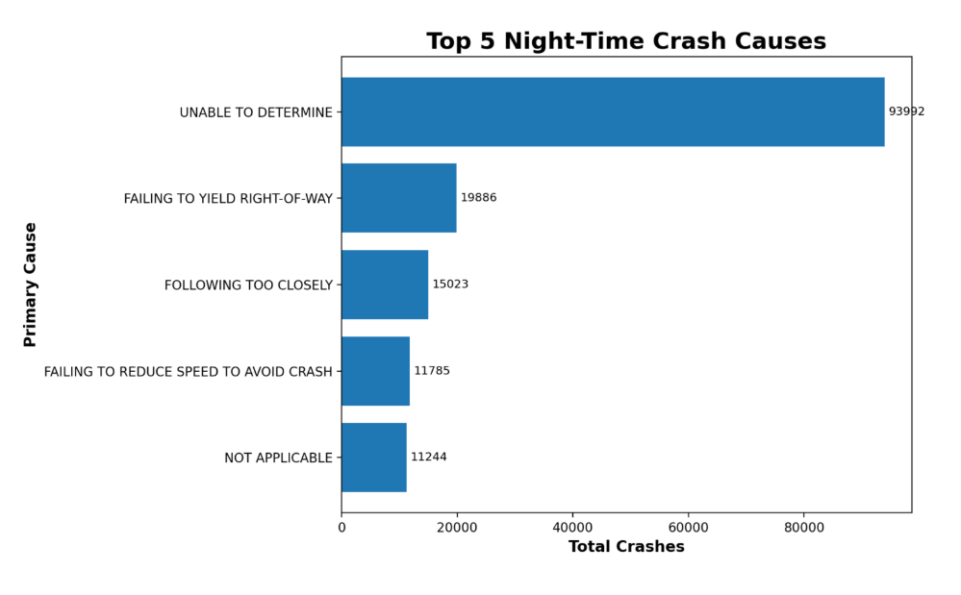

Slide 18
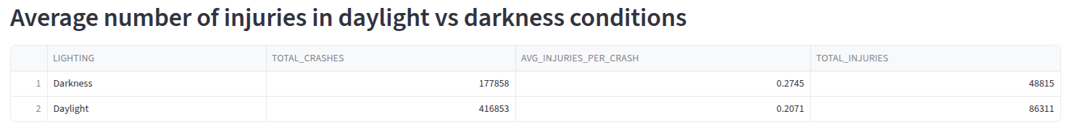
Average number of injuries in daylight vs darkness conditions
Insight:
Daylight conditions recorded the highest number of crashes and total injuries due to heavier traffic volume, while darkness-related crashes showed a higher average injury rate per crash, indicating greater severity at night. This suggests that reduced visibility, driver fatigue, and slower reaction times increase injury risk during darkness conditions.

Slide 19
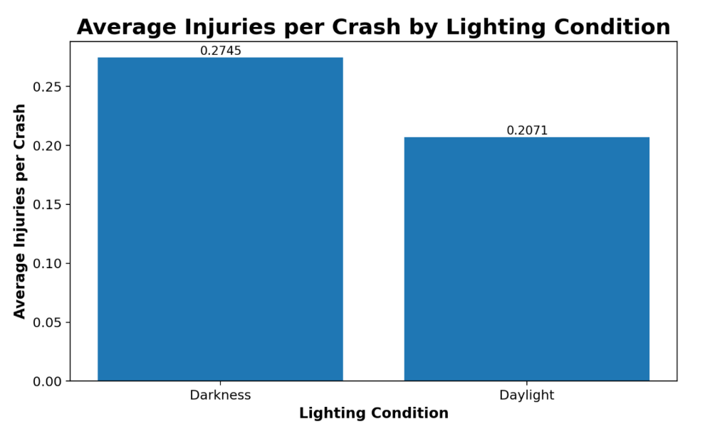

Slide 20
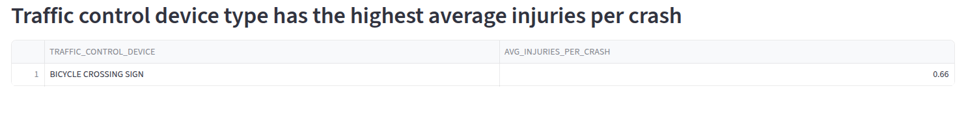
Traffic control device type has the highest average injuries per crash
Insight:
Crashes near Bicycle Crossing Sign locations recorded the highest average injuries per crash, indicating that bicycle crossing zones are high-risk areas due to the vulnerability of cyclists and interactions with vehicles. This highlights the need for improved lighting, road markings, speed control, and dedicated cycling safety measures in these areas.

Slide 21
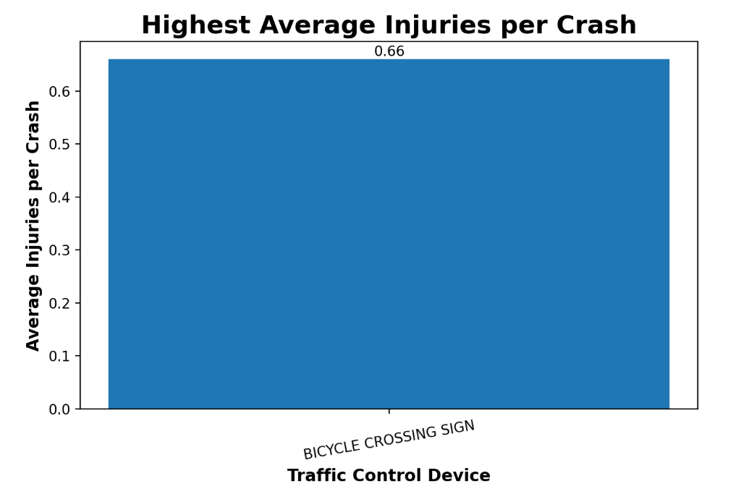

Slide 22
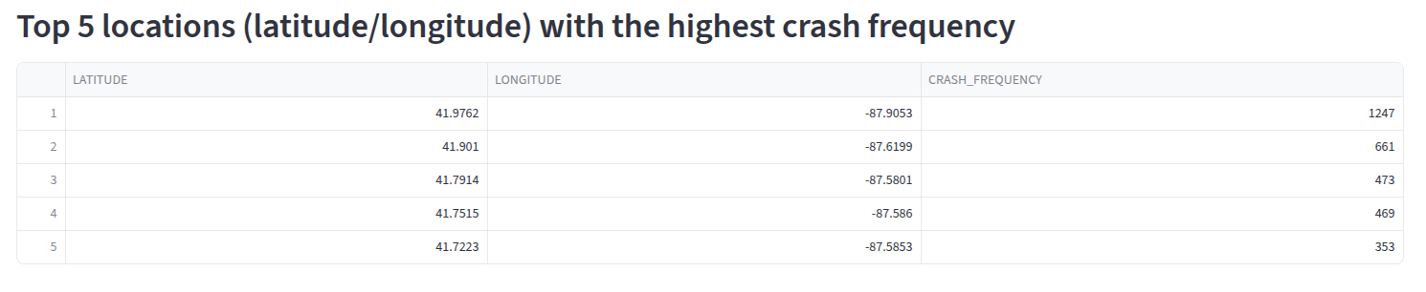
Top 5 locations (latitude/longitude) with the highest crash frequency
Insight:
The location at latitude 41.9762 and longitude -87.9053 recorded the highest crash frequency, making it a major accident hotspot likely influenced by heavy traffic, congestion, or complex road layouts. The consistently high crash counts across the top locations highlight the need for targeted safety measures such as improved signals, signage, speed management, and roadway redesign.

Slide 23
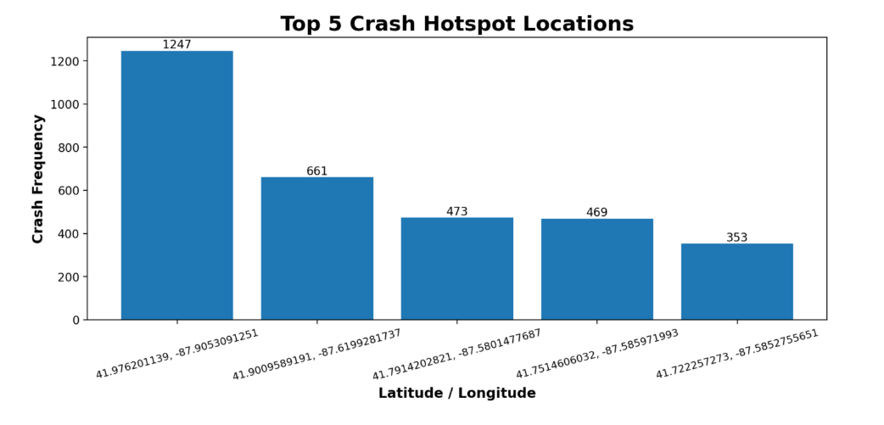

Slide 24
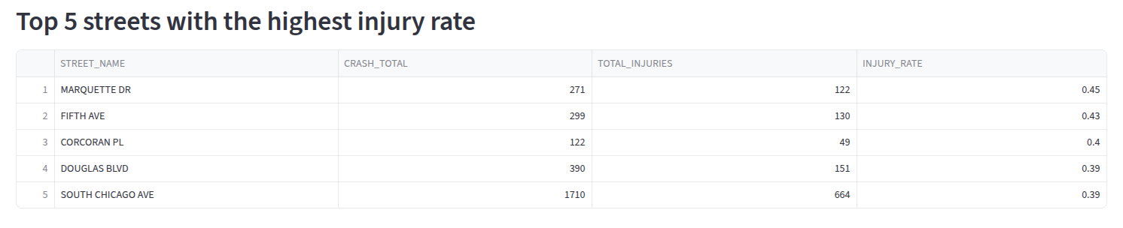
Top 5 streets with the highest injury rate
Insight:
Marquette Dr recorded the highest injury rate, while Fifth Ave and Corcoran Pl also showed severe injury-related crash patterns, indicating that crashes on these streets are more likely to cause injuries. South Chicago Ave stood out as both a high-frequency and high-severity crash corridor, highlighting the need for improved traffic safety measures and infrastructure.

Slide 25
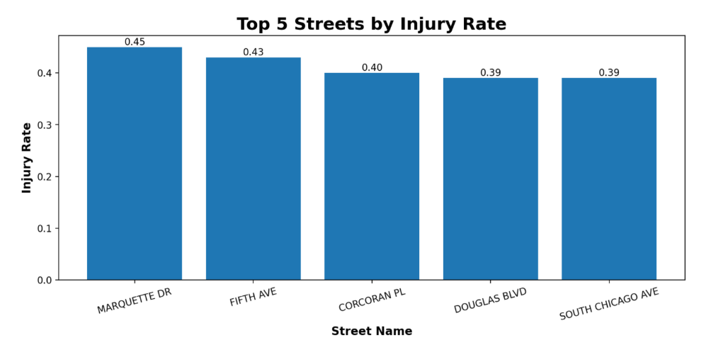

Slide 26
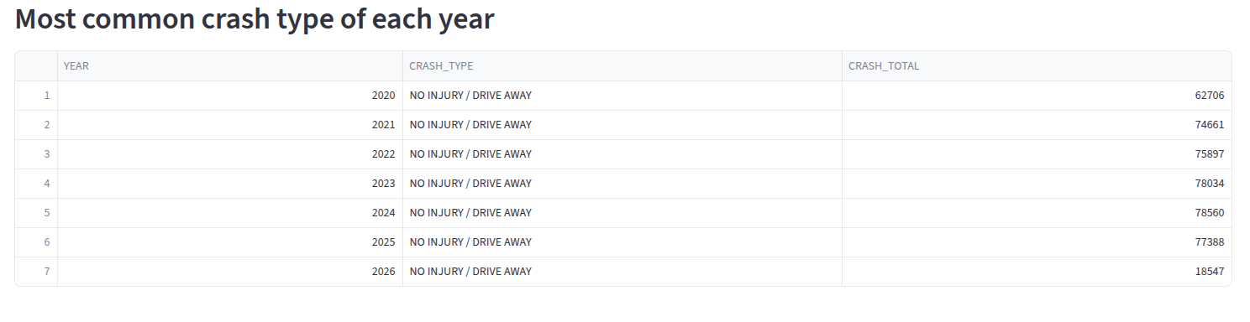
Most common crash type of each year
Insight:
'NO INJURY / DRIVE AWAY' remained the most common crash type from 2020 to 2026, showing that most crashes were relatively minor and non-severe. The steady increase in crash totals until 2024 reflects rising traffic activity, highlighting the need for better traffic management and preventive road safety measures.

Slide 27
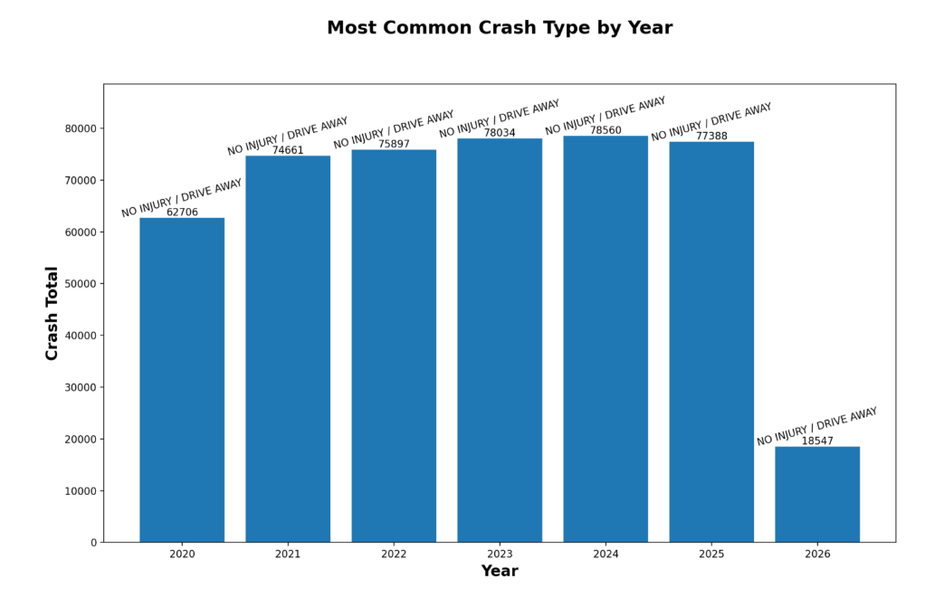

Slide 28
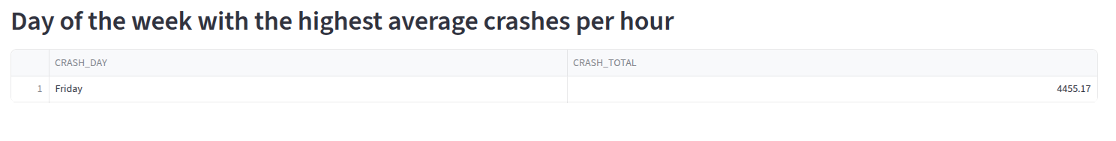
Day of the week with the highest average crashes per hour
Insight:
Friday recorded the highest average crashes per hour, indicating that end-of-week traffic, commuter movement, and increased social travel significantly raise accident risk. The result highlights Fridays as high-risk periods requiring stronger traffic monitoring and road safety enforcement.

Slide 29
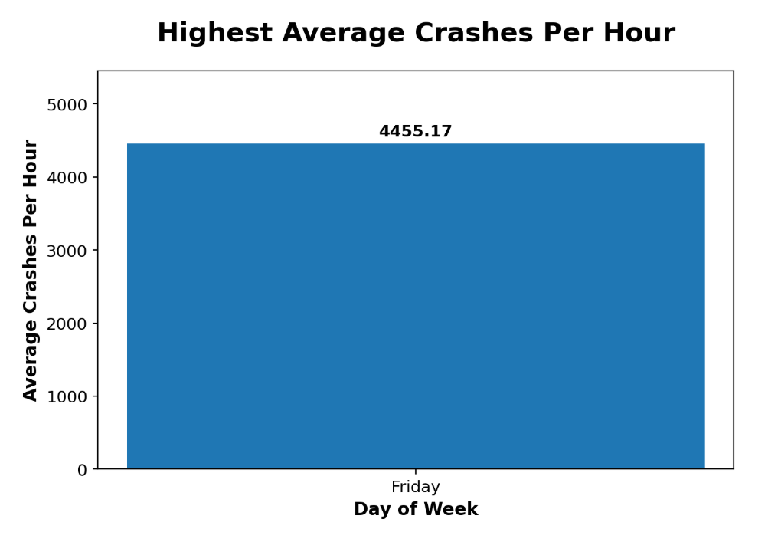

Slide 30
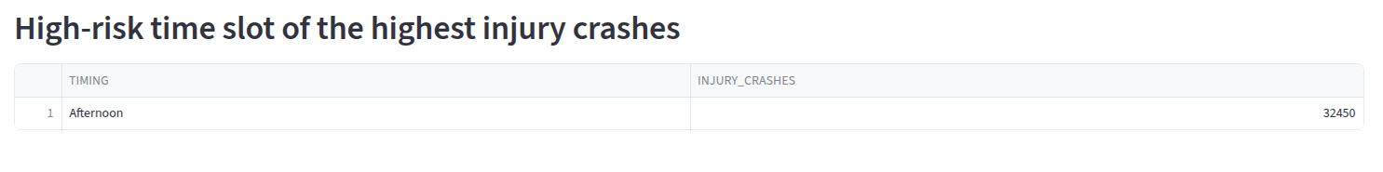
High-risk time slot of the highest injury crashes
Insight:
The Afternoon time slot recorded the highest number of injury crashes, indicating that heavy daytime traffic, commuter activity, and increased pedestrian movement significantly raise accident risk during this period. This highlights the need for stronger traffic monitoring, speed control, and intersection management during peak afternoon hours.

Slide 31
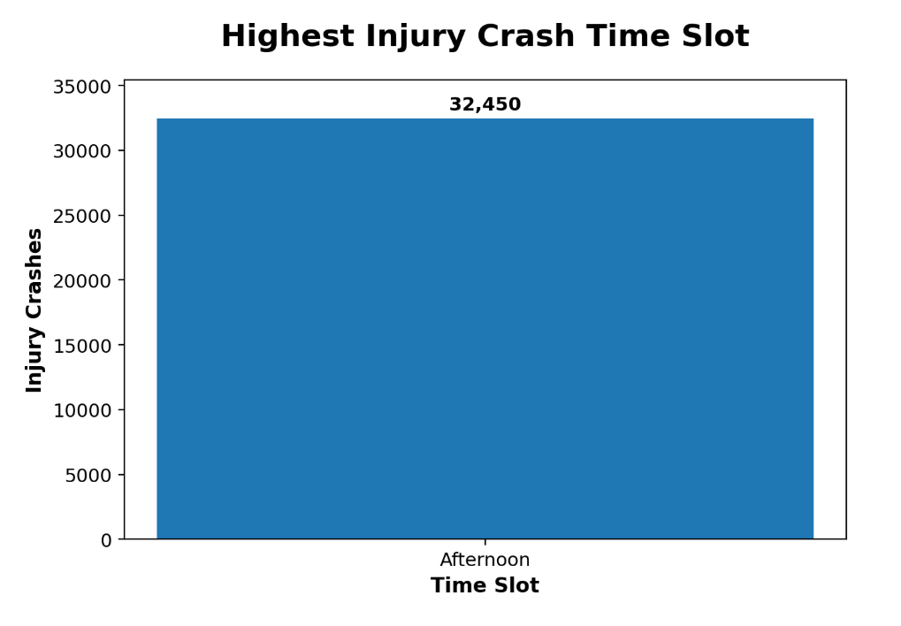

Slide 32
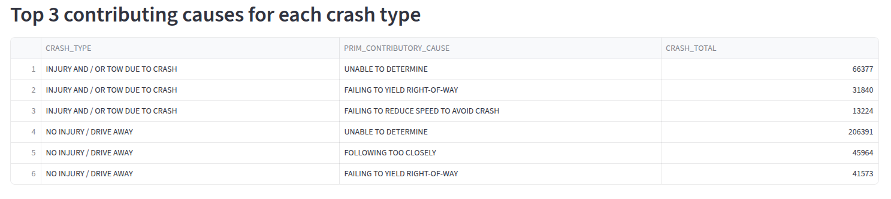
Top 3 contributing causes for each crash type
Insight:
'UNABLE TO DETERMINE' was the leading contributing cause across both major crash categories, while failing to yield, speeding-related behavior, and following too closely were major identifiable causes of severe and minor crashes. The findings highlight the strong impact of driver behavior on crash occurrence and emphasize the need for improved driver awareness, speed control, and traffic enforcement.

Slide 33
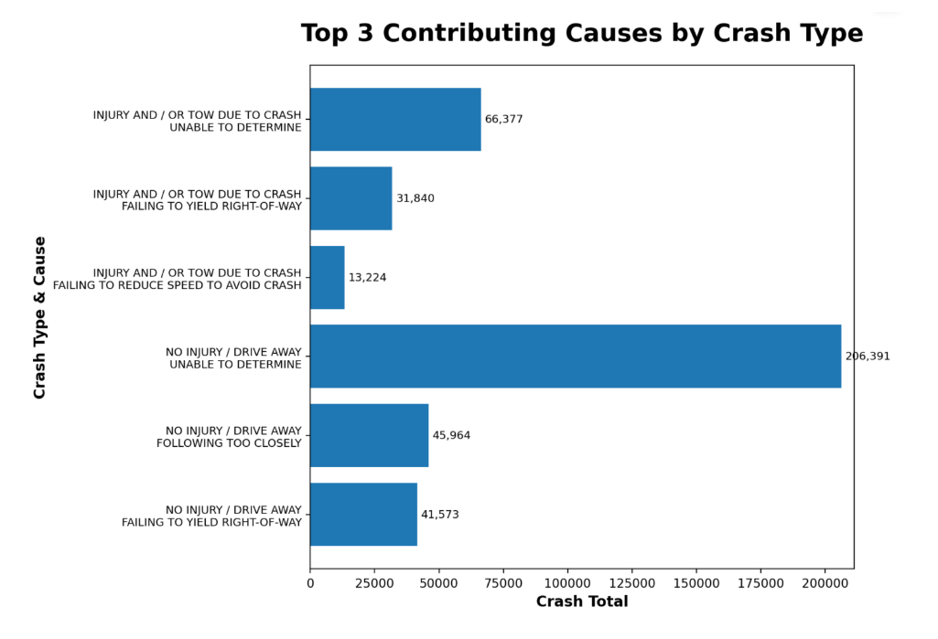

Slide 34
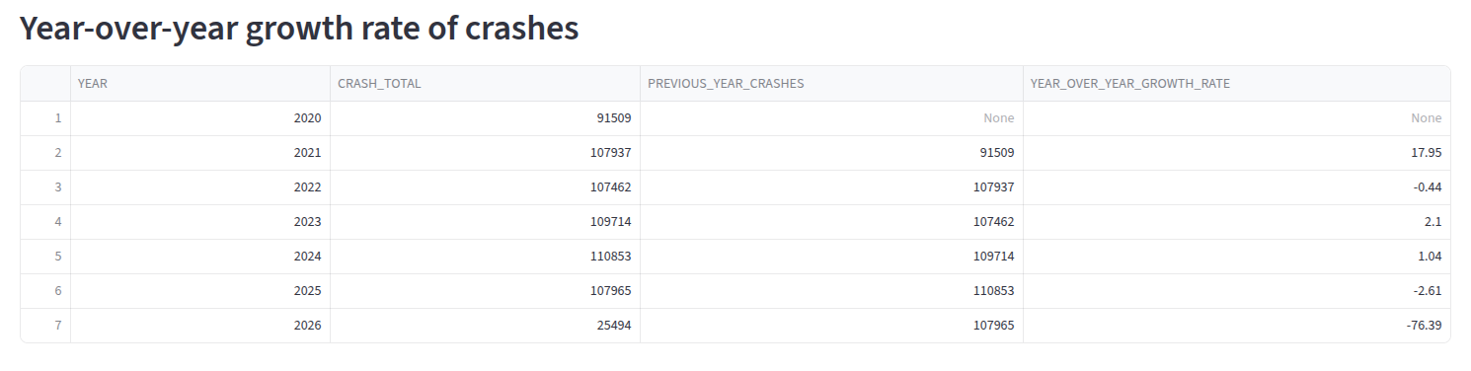
Year-over-year growth rate of crashes
Insight:
Crash frequency saw its largest increase in 2021 after the lower traffic levels of 2020, then remained relatively stable with only minor fluctuations between 2022 and 2025. The sharp decline in 2026 is likely due to incomplete data rather than an actual reduction in crashes.

Slide 35
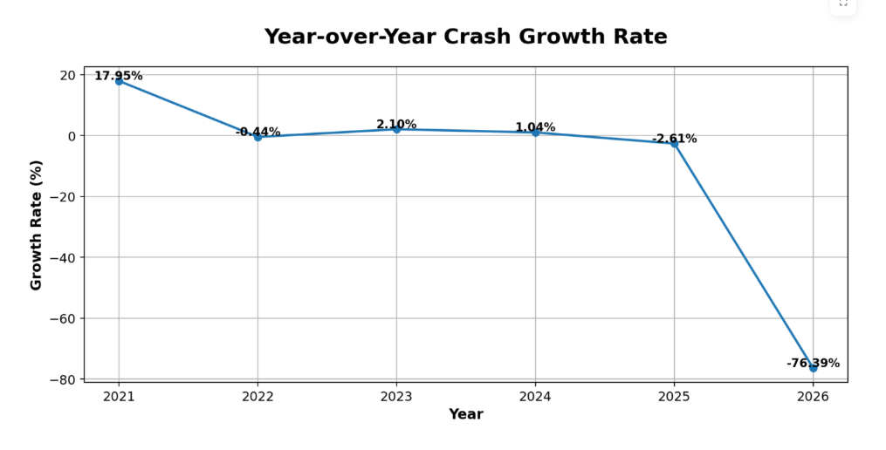

Slide 36
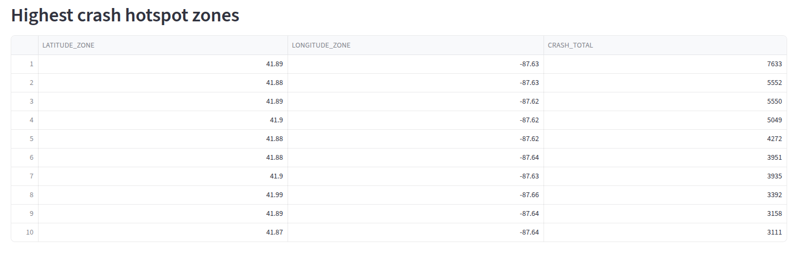
Highest crash hotspot zones
Insight:
Crash incidents were heavily concentrated in a few hotspot zones, with the area around latitude 41.89 and longitude -87.63 recording the highest crash frequency. The clustering of crashes within nearby urban corridors suggests that dense traffic, major intersections, and congestion-prone road networks significantly increase accident risk.

Slide 37
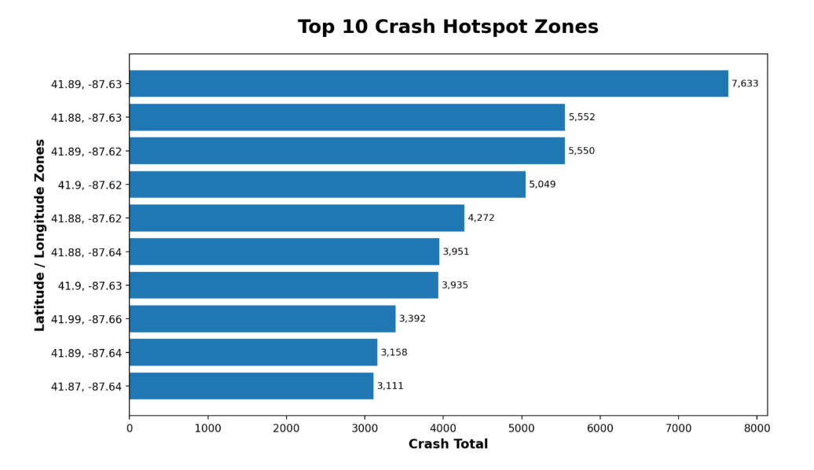

Slide 38
Technologies Used
Python for analytics and development.
MySQL for database management.
Streamlit for dashboard visualization.
Pandas for data analysis.
Matplotlib for charts.

Slide 39
Conclusion
The platform converts raw crash data into meaningful insights.
Supports better traffic safety planning and management.

